Slide 1


Artificial Intelligence
&
Machine Learning

Slide 2
Team Details
Emp ID | Name | Email ID | Phone No. | Account Name | Supervisor Name | Supervisor Emp ID
587830 | Monica Subramanian | monica.subramanian@tcs.com | 9790847922 | Humana | Santhosh Natarajan | 882360
1113134 | Mohan Rajendran | mohan.rajendran1@tcs.com | 9840374703 | Humana | Santhosh Natarajan | 882360
181808 | Hemavathy Gopi | hemavathy.g@tcs.com | 9789951025 | Humana | MathiMohan K | 183324
Notes:
B1 is the slope of the line.
CM = 65+24 correct prediction, 8+3 incorrect prediction

Slide 3
Use Case Description
Customer retention in health insurance company :
Existing customer will be retained or not with the current medical insurance policy benefits
It is very crucial factor now to understand why existing customer is moving out as there are various factor – poor customer service, not happy with the coverage benefits, cost etc
Considering this it is always good to analyse the customer churn rate every year and to identify the trend and the reasons for the customer moving out from the current medical insurance policy. This will make us to understand the major reason and improvising that particular area in order to retain the customer. As we know the amount spend for getting a new customer is higher always than retaining the existing customer
In our case the objective is reducing customer churn by identifying potential churn candidates beforehand, and take proactive actions to make them stay.
Notes:
B1 is the slope of the line.
CM = 65+24 correct prediction, 8+3 incorrect prediction

Slide 4
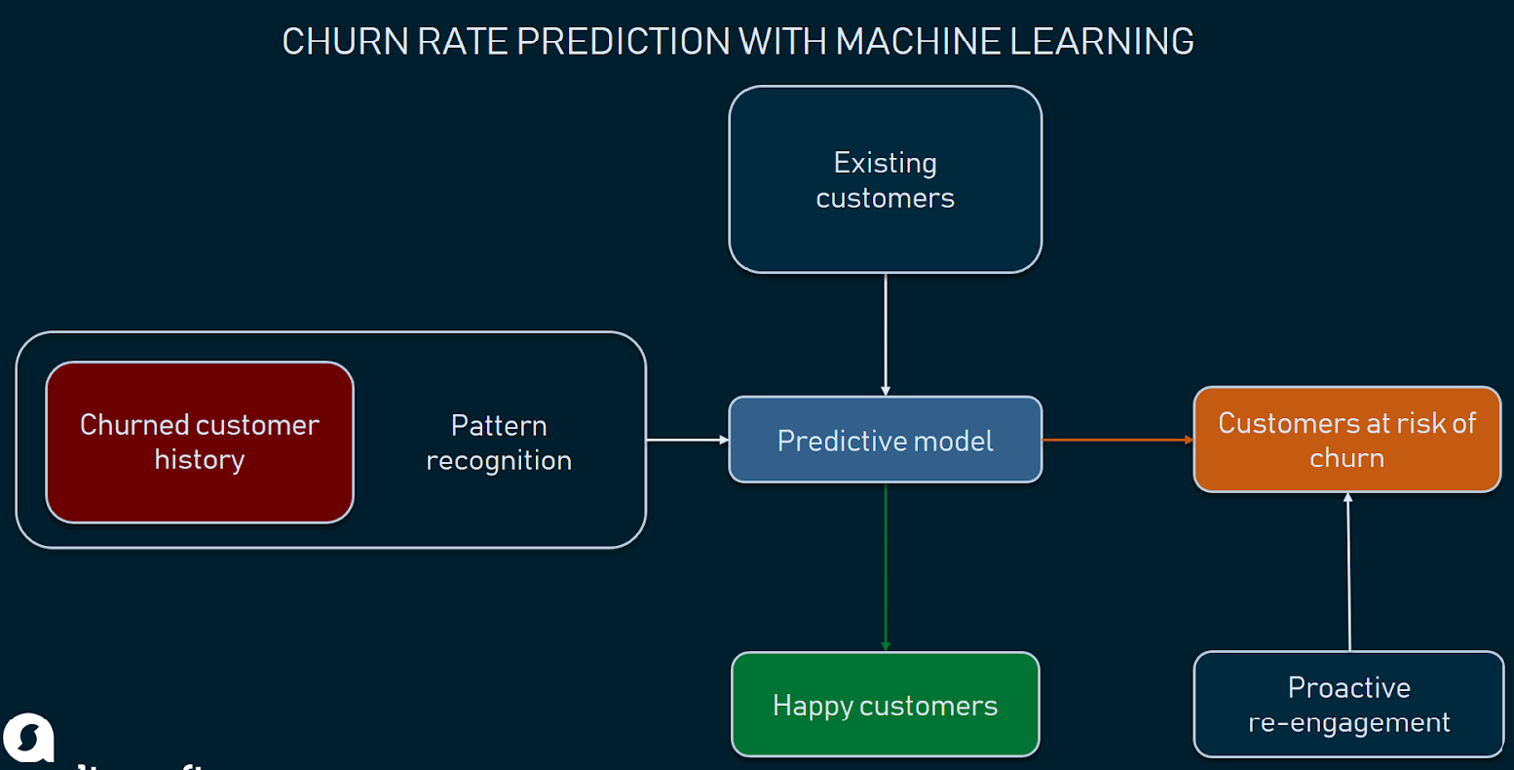
CHURN RATE PREDICTION WITH MACHINE LEARNING
Notes:
B1 is the slope of the line.
CM = 65+24 correct prediction, 8+3 incorrect prediction

Slide 5
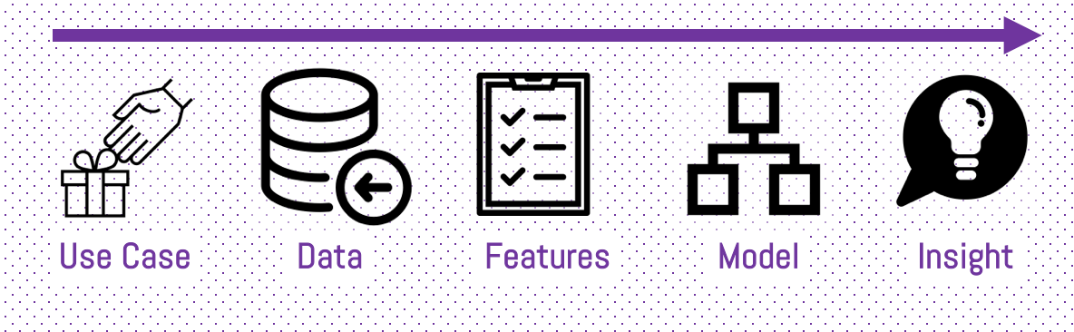
HIGH LEVEL PROCESS

Slide 6
Steps followed:
Data collection & cleaning
With understanding the context it is possible to identify the right data sources, cleansing the data sets and preparing for feature selection or engineering. It sounds quite simple, but this is likely the hardest part. The predicting model is only as good as the data source. And especially Startups or small companies have often trouble to find enough data to train the model adequately.
Feature selection & engineering
With the third step we decide which features we want to include in our model and prepare the cleansed data to be used for the machine learning algorithm to predict customer churn.
Gather available customer behavior, transactions, demographics data and usage patterns
Utilize these data points to predict customer segments who are likely to churn
Notes:
B1 is the slope of the line.
CM = 65+24 correct prediction, 8+3 incorrect prediction

Slide 7
Steps followed:
Modelling
With the prepared data we are ready to feed our model. But to make good predictions, we firstly need to find the right model (selection) and secondly need to evaluate that the algorithm actually works. While this usually takes a few iterations, we will keep this quite simple and stop as soon as the results fit our needs.
Create a model to pattern the risk tolerance of the business with respect to churn probability.
Design an intervention model to consider how the level of intervention could affect the churn percentages and customer lifetime value (CLV)
Implement effective experimentation across multiple customer segments for reducing churn and promoting retention.
Notes:
B1 is the slope of the line.
CM = 65+24 correct prediction, 8+3 incorrect prediction

Slide 8

Steps followed:
Insights and Actions
Last but not least we have to evaluate and interpret the outcomes. What does it mean and what actions can we derive from the results? Because predicting customer churn is only half of the part and many people forget that by just predicting, they can still leave. In our case we actually want to make them stop leaving.
Notes:
B1 is the slope of the line.
CM = 65+24 correct prediction, 8+3 incorrect prediction

Slide 9
Planned Libraries to be used
Technology Details:
Technology (Planned)
Python
Input Data (Source)
User Feedback - Via online consumer forum/Google forms from users
Libraries
numpy
pandas
matplotlib.pyplot
Notes:
B1 is the slope of the line.
CM = 65+24 correct prediction, 8+3 incorrect prediction

Slide 10
Thank you!

